Slide 1
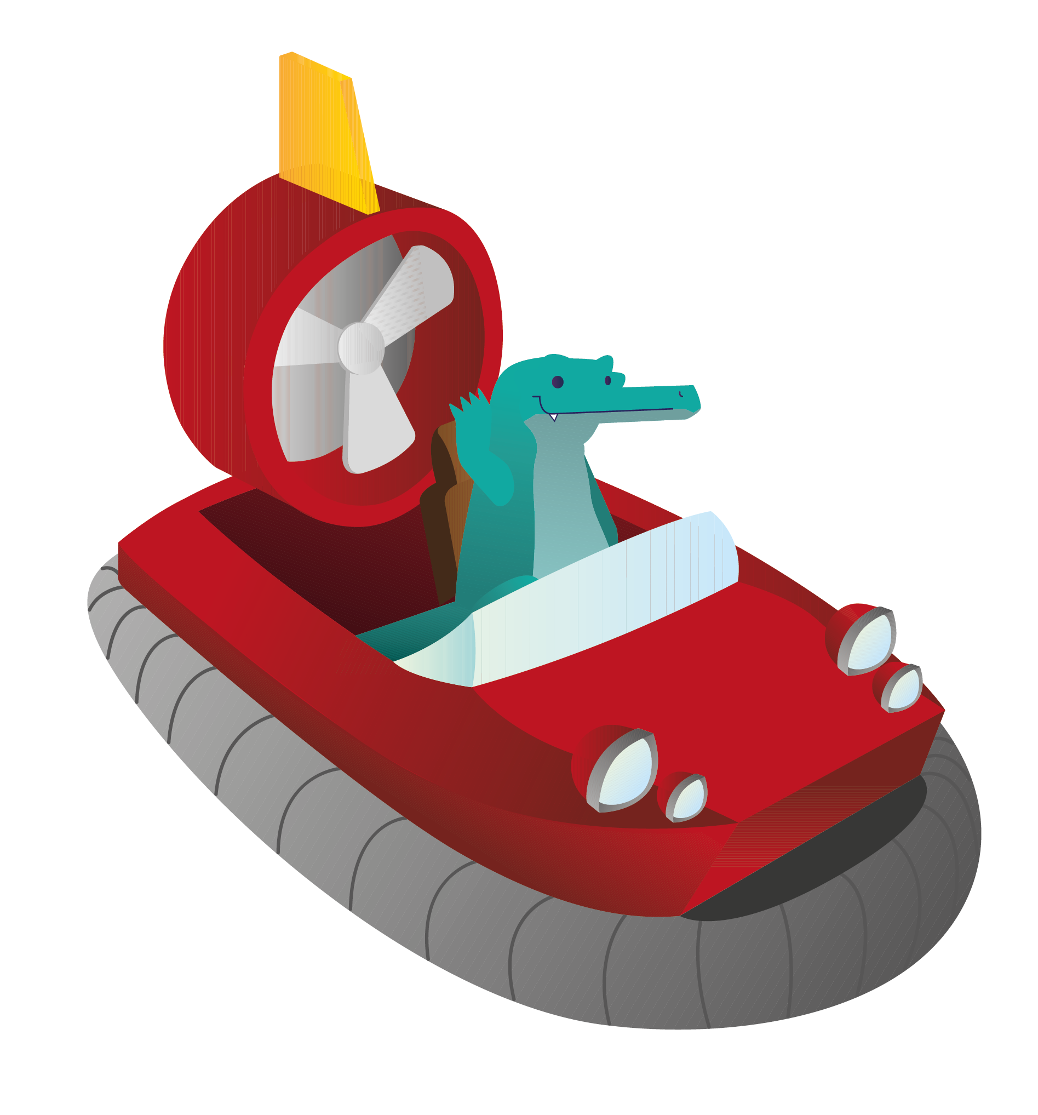

WIL Implementation

Slide 2
High level structure
Hw part:
  Position tracking
  Physical game
Sw part:
  Position data elabotation
  Videogame
Middleware part:
  Bluetooth communication between the electronic board and the tablet

Slide 3
High level structure
Hw:
  Arduino board(UNO)
  LSM303 accelerometer
Sw:
  Unity3D
Middleware:
  HC05 or HC06

Slide 4
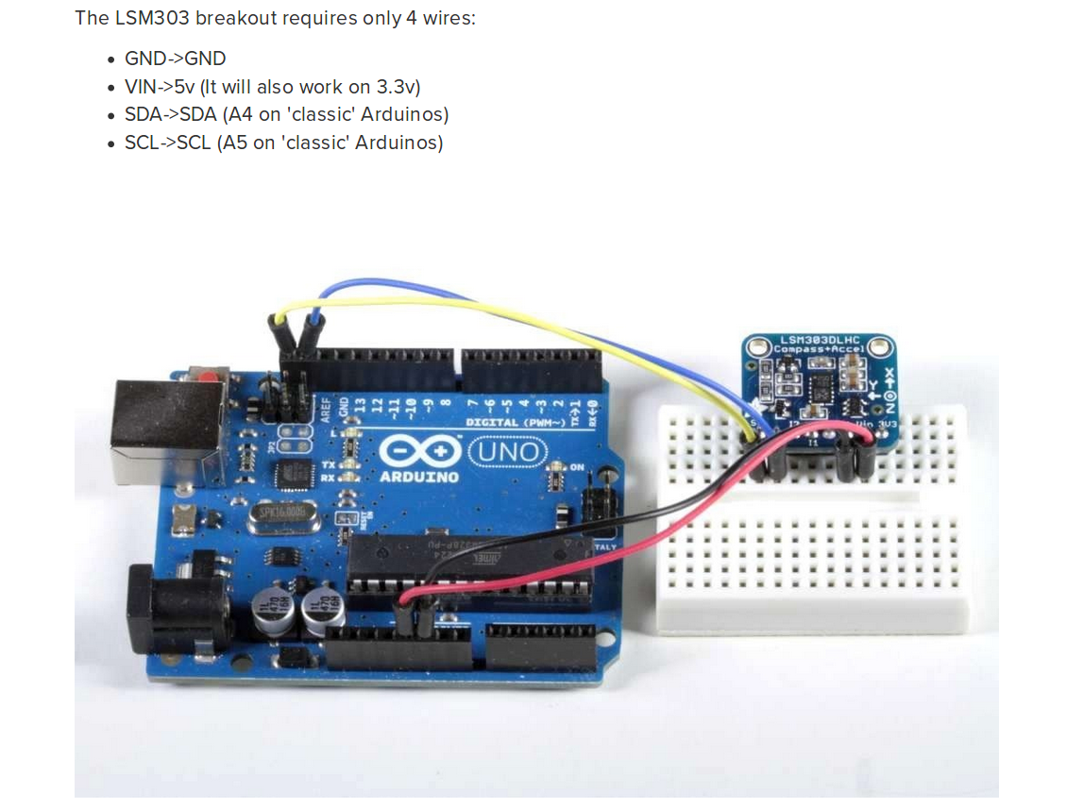
LSM303 connection

Slide 5
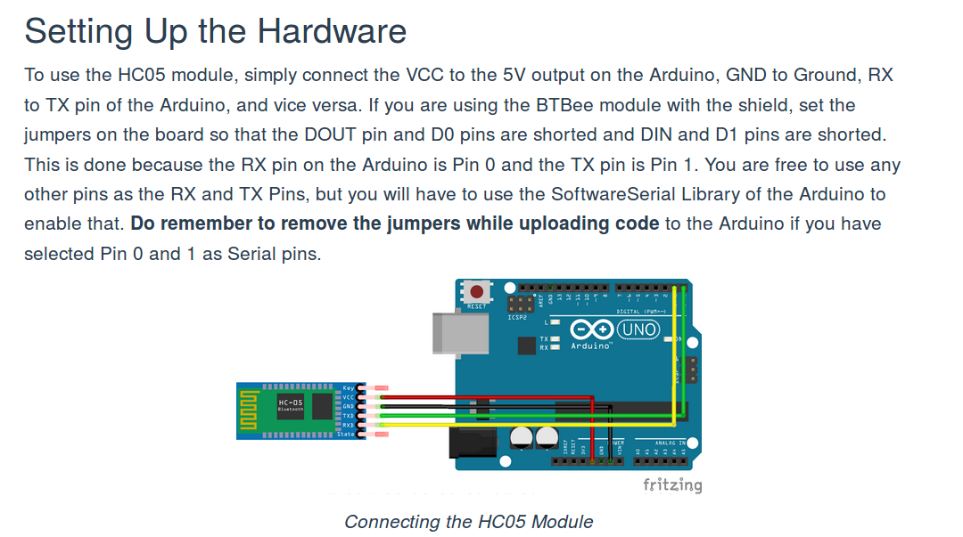
HC05(or HC06) connection

Slide 6
Arduino sketch idea
When the board is moved, the Arduino board gets acceleration information from LSM303
And then evaluates the position
  Initial position = (0,0,0)
  Initial speed = 0
  A timeout is used to know wether the board is continuously moving or only “step-moves” are performed
The position evaluated is passed to the tablet via Bluetooth(HC05/HC06)

Slide 7
Sw side
The game-setting phase is started
The communication with the board is started
For a certain amount of time, stores data passed by the board
The communication is closed
Position data are analyzed to elaborate the new circuit
The videogame is started with the new circuit

Slide 8
Sketch’s notes
Need to set a tollerance for the movements
  Position sample is “useful” only if there is a “noticeable” variation in the position of the board
Sampling rate is not constant
  Need to keep track of the “delta t”
  But only useful positions are get
Accelerometer introduces some measurement error
Bluetooth communication can introduce some sampling rate constraints
  Need of buffers?

